Slide 1
Satyam ChangeMan
Implementation
GE Capital Finance
27 April 2004

Slide 2
Overview of ChangeMan for GECF
Vision Plus
What is ChangeMan:
Change Man is a comprehensive system designed to provide reliable and streamlined implementation of software changes on the mainframe MVS system. It is a system that manages and automates the process of migrating software changes, or applications, from a development environment to any test environment and finally, to the production environment.
ChangeMan manages the complete cycle of any change, from the first step of retrieving the components from the most current version of the production environment, to the final step of moving those modified components back into production and updating the libraries to reflect the updated versions.

Slide 3
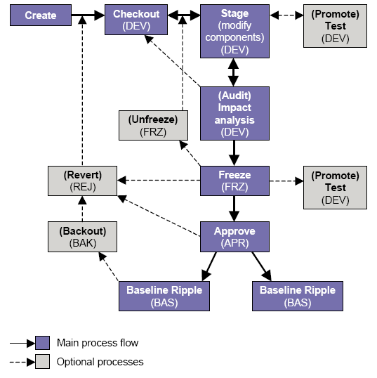
Life Cycle flow

Slide 4
Package Creation
- Package Creation means Creation of a Change Package
in the chosen application.
27 April 2004

Slide 5
Check out
- Checkout existing production components from the
baseline or promotion environments to the change
package.

Slide 6
Edit & Stage
  - All components of a Change Package are edited and staged. For program source components, the stage process includes the program compilation and link.
New components are staged from the development
library, where the components have been created by
the developer.
27 April 2004

Slide 7
Promotion to Testing Environments.
- Promotion to testing environments includes promotion of a Change Package into 3 standard testing environments namely
1. Devt(Development)
2. Intg(Integration)
3. Acpt(Acceptance)
Promotion to Acceptance region(ACPT) will be done after Audit has been performed and Package in Frozen state.
27 April 2004

Slide 8
Audit Package
- An audit of the change package must be conducted before we freeze. The inspection looks for situations such as a package that shows no change from the Baseline library, or a package containing a LOD component that does not match its SRC component.
27 April 2004

Slide 9
Package Freeze
- The change package must be frozen before promoting the package to Acceptance testing environment.
27 April 2004

Slide 10
Promotion to Acceptance region
- Acceptance region is the final testing environment to which the Change Package has to be promoted to and is before the production environment. Before promotion to Acceptance region, the Change Package must undergo an audit check as well as a freeze.
27 April 2004

Slide 11
Approvals
- Approval process is the step which is basically like an electronic sign-off. Only after the necessary approvals are granted at various levels, the change package will be promoted to Production. This approval process is specific to the site where the ChangeMan implementation is done depending on their business needs. Either the Business team at the site or the IT team should determine the level of approvals they require so that the ChangeMan team can configure the approval levels at an higher level(Admin). In an Ideal situation, there should be 4 levels of approvals, 1st level, DEVT sign off, 2nd level, ACPT signoff, 3rd level, PROD SUPP signoff and the final, CSC signoff for production installation. The admin should have the option to select the level of approvals for their business while setting up the parameters of the application.
27 April 2004

Slide 12
Backout the package
Backout is not strictly part of the ChangeMan life cycle. The Backup/Install routines take a copy of the production components that will be replaced by the change to be installed. This is stored in a backup library(ies), and remains there in anticipation of a possible Backout. Should Backout be required, the Backout jobs built at Freeze time are submitted to perform a Reverse Copy, and a Reverse Baseline Ripple. The saved production component is restored to the target libraries, and the ChangeMan records reflect the ‘backed-out’ situation. The changes still reside in the staging libraries for that change, and can be re-processed after correcting any errors.

Slide 13
Revert package
To edit a component inside the package, which is in FRZ or BAK status we need to Revert the package which changes the status of package to DEV.

Slide 14
Thanks

